Slide 1

Amazon Reviews Classification
Steven Lee | DSI 19

Slide 2


Problem Statement
Amazon Dataset
34GB raw review data with 233.1 million reviews (May 1996 - Oct 2018)
12GB product meta data of 15.5 million products
That is a whole lot of data to just do sentiment analysis
Goal
Build a multi-class classification model to categorize review data into meaningful subject matter, and hopefully, provide new and valuable insights to business owners
Topic Modeling (NLP) is a technique to extract the hidden topics from large volumes of text
Notes:
The aim is to hopefully be able to gain some useful insights from the categorical data after classification e.g. problems with deliveries, product defects, etc..

Slide 3
Approach
Preprocess
Model
Infer

Slide 4
Preprocess
Drop review duplicates
Drop rows where both review text and summary are null
Drop rows where review text is null and summary contains only rating information. Otherwise, replace review text with summary data
Remove newline and apostrophe backslash delimiter characters
Remove “http(s):\\*” and “*.com” URLs
Drop rows with review text word count < 5 or > 128
Drop product duplicates
Clean-up product categories
Tokenize, Lemmatize and remove Stop Words to create documents / bag of words
Notes:
Pretty standard activities.. Perhaps 2 worth mentioning would be, first.. Some records were found with empty review text. Now, any data scientist would of course try to impute from other data items.
As it turns out there is a summary column for that. However, upon inspection, some of the summary data only included rating information e.g. * star(s).
I figured that this would not be helpful, so I only impute otherwise and dropped those with only rating information.
The other thing is regarding the number of words in the review text. I found some with over 1000 words e.g. ... So, I checked and found that if I kept it between 5 and 128 words inclusive, I could still retain a large portion of the data. I dropped those beyond the range.

Slide 5
Model Latent Dirichlet Allocation
Latent Dirichlet Allocation (LDA) is a popular probabilistic topic model
Gensim library
LdaMulticore / Mallet
LDA considers every topic a collection of keywords in various proportions, and every document a collection of topics in various proportions
Comparison of Variational Bayes and Gibbs Sampling
Notes:
In the Gensim package there are a few LDA models. The standard one named ldamodel is single core. The algorithm for this is:
Streamed: processes documents sequentially, no random access required
Runs in constant memory w.r.t. the number of documents: the size of the training corpus does not affect memory footprint i.e. can process corpora larger than available RAM
Is distributed: makes use of a cluster of machines, if available
There is also the ldamulticore, which is essentially the same algorithm but parallelized for multiprocessing
Naturally, I ended up using the latter as my baseline model and then subsequently compared it with Mallet’s model
Mallet is a Java topic modelling toolkit provided as a Python wrapper in Gensim, Java RE.. Mallet however, requires the entire corpus to be kept in RAM while training
The other difference between the two is that ldamulticore uses Variational Bayes Sampling while Mallet uses Gibbs Sampling, which is more precise but slower

Slide 6
Model Latent Dirichlet Allocation
Topic modeling visualization – How to present the results of LDA models?
Notes:
Ignore the meaning of the words for now..
Each line.. Each colour.. Colour of the document box..

Slide 7
Model Coherence
Coherence score measures the relative distance between words
The overall coherence score of a topic is the average of the distances between words
LdaMulticore’s LDA Coherence Score: 0.5029
Mallet’s LDA Coherence Score: 0.6024
Evaluate Topic Models: Latent Dirichlet Allocation (LDA)
Notes:
Translated to NLP terms, it is a measure of the degree of semantic similarity between the high scoring terms of a topic.
Based on what I’ve read..

Slide 8
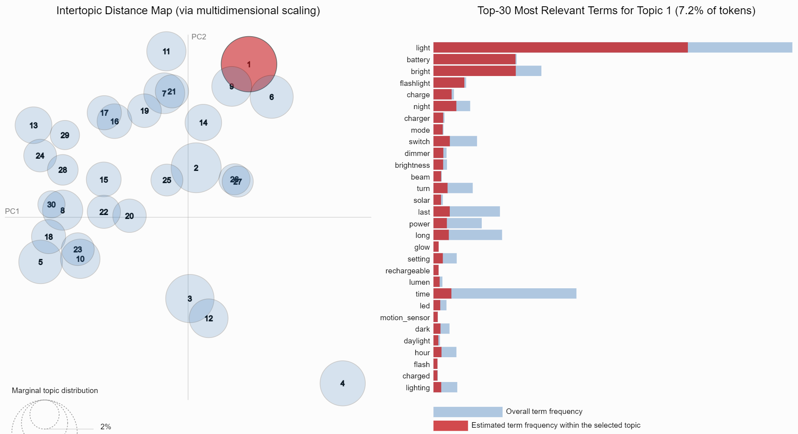
Infer
Notes:
This is probably the best LDA visualization to explain the results of the modelling, not to say that the rest are not important
In my demo at the end I will go through this in more detail. This vis provides some interactivity that you cannot experience here because this is just a captured image
For now just note that there are 30 topics represented here by the circles on the left. The intertopic distance is approximated in this 2D space thru dimensionality reduction

Slide 9
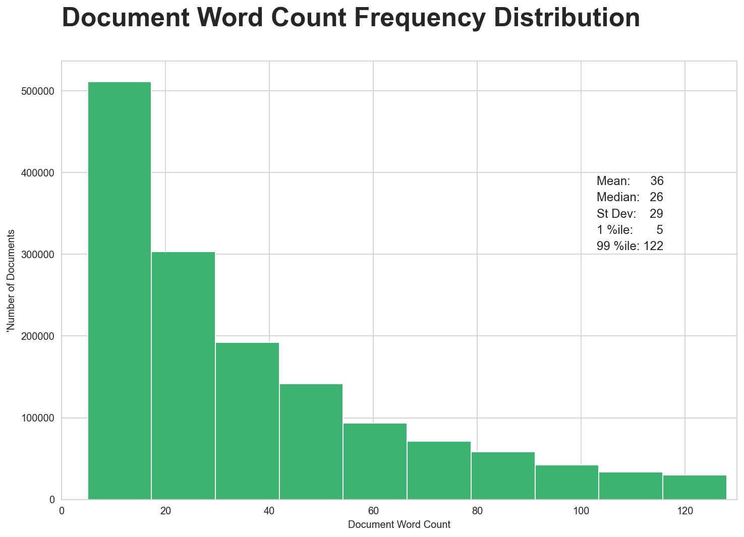
Infer

Slide 10
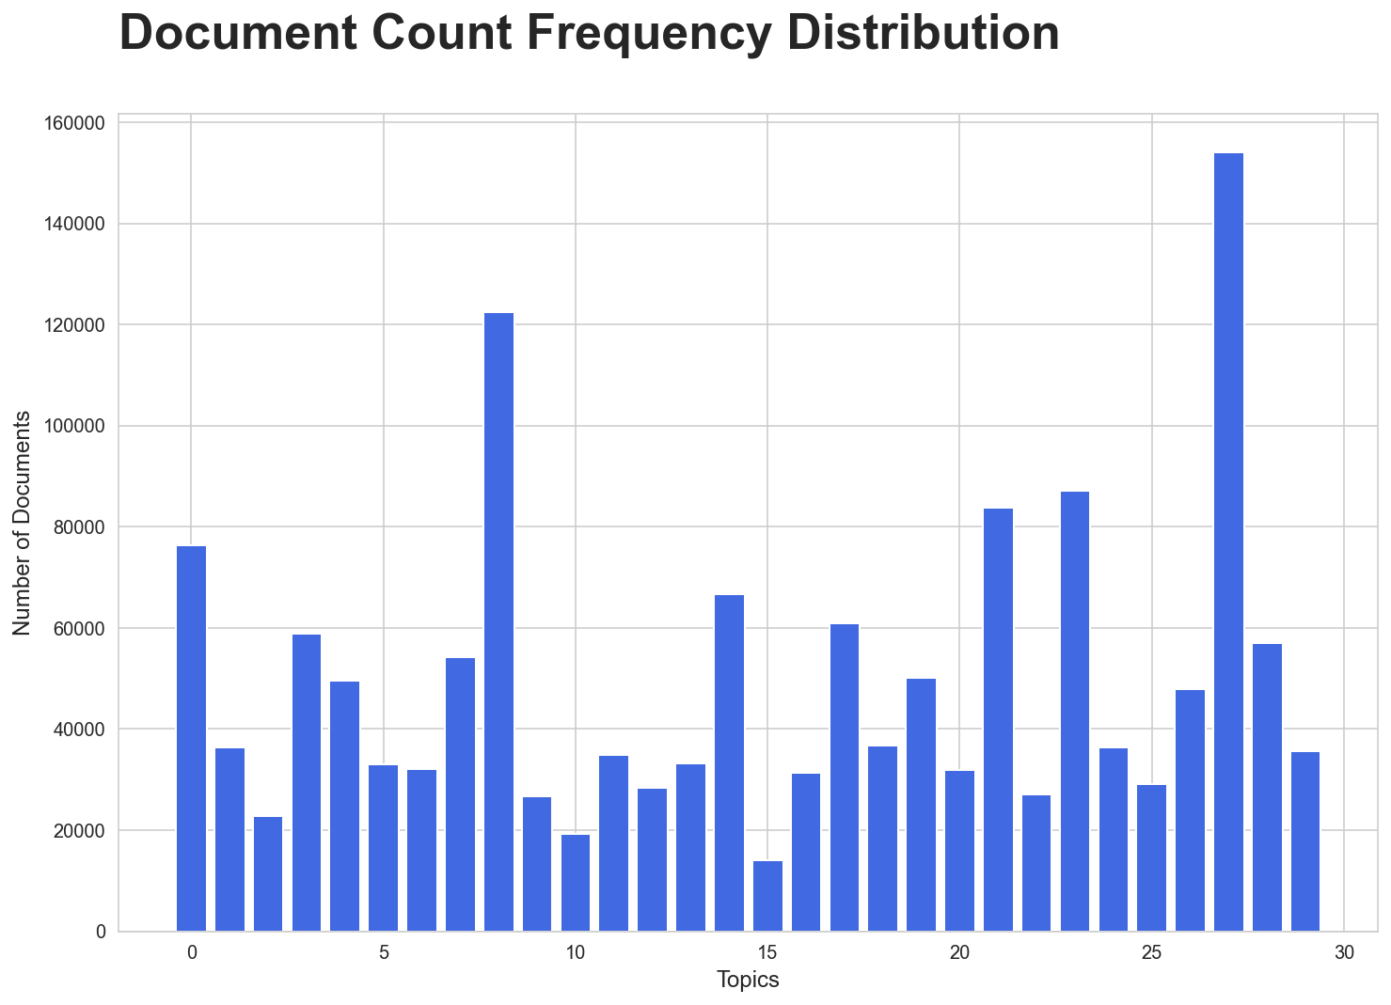
Infer

Slide 11
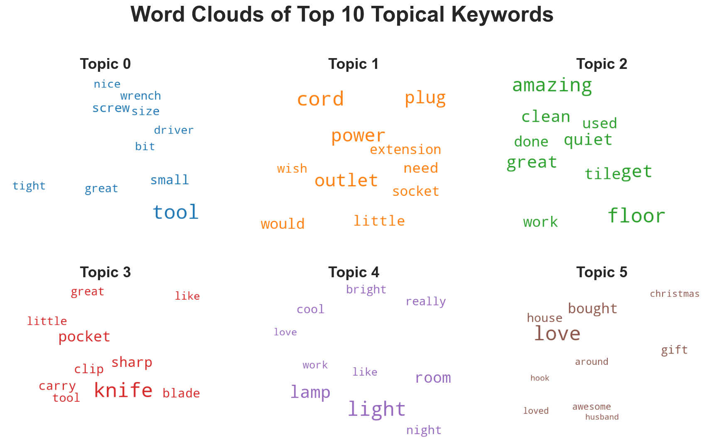
Infer

Slide 12
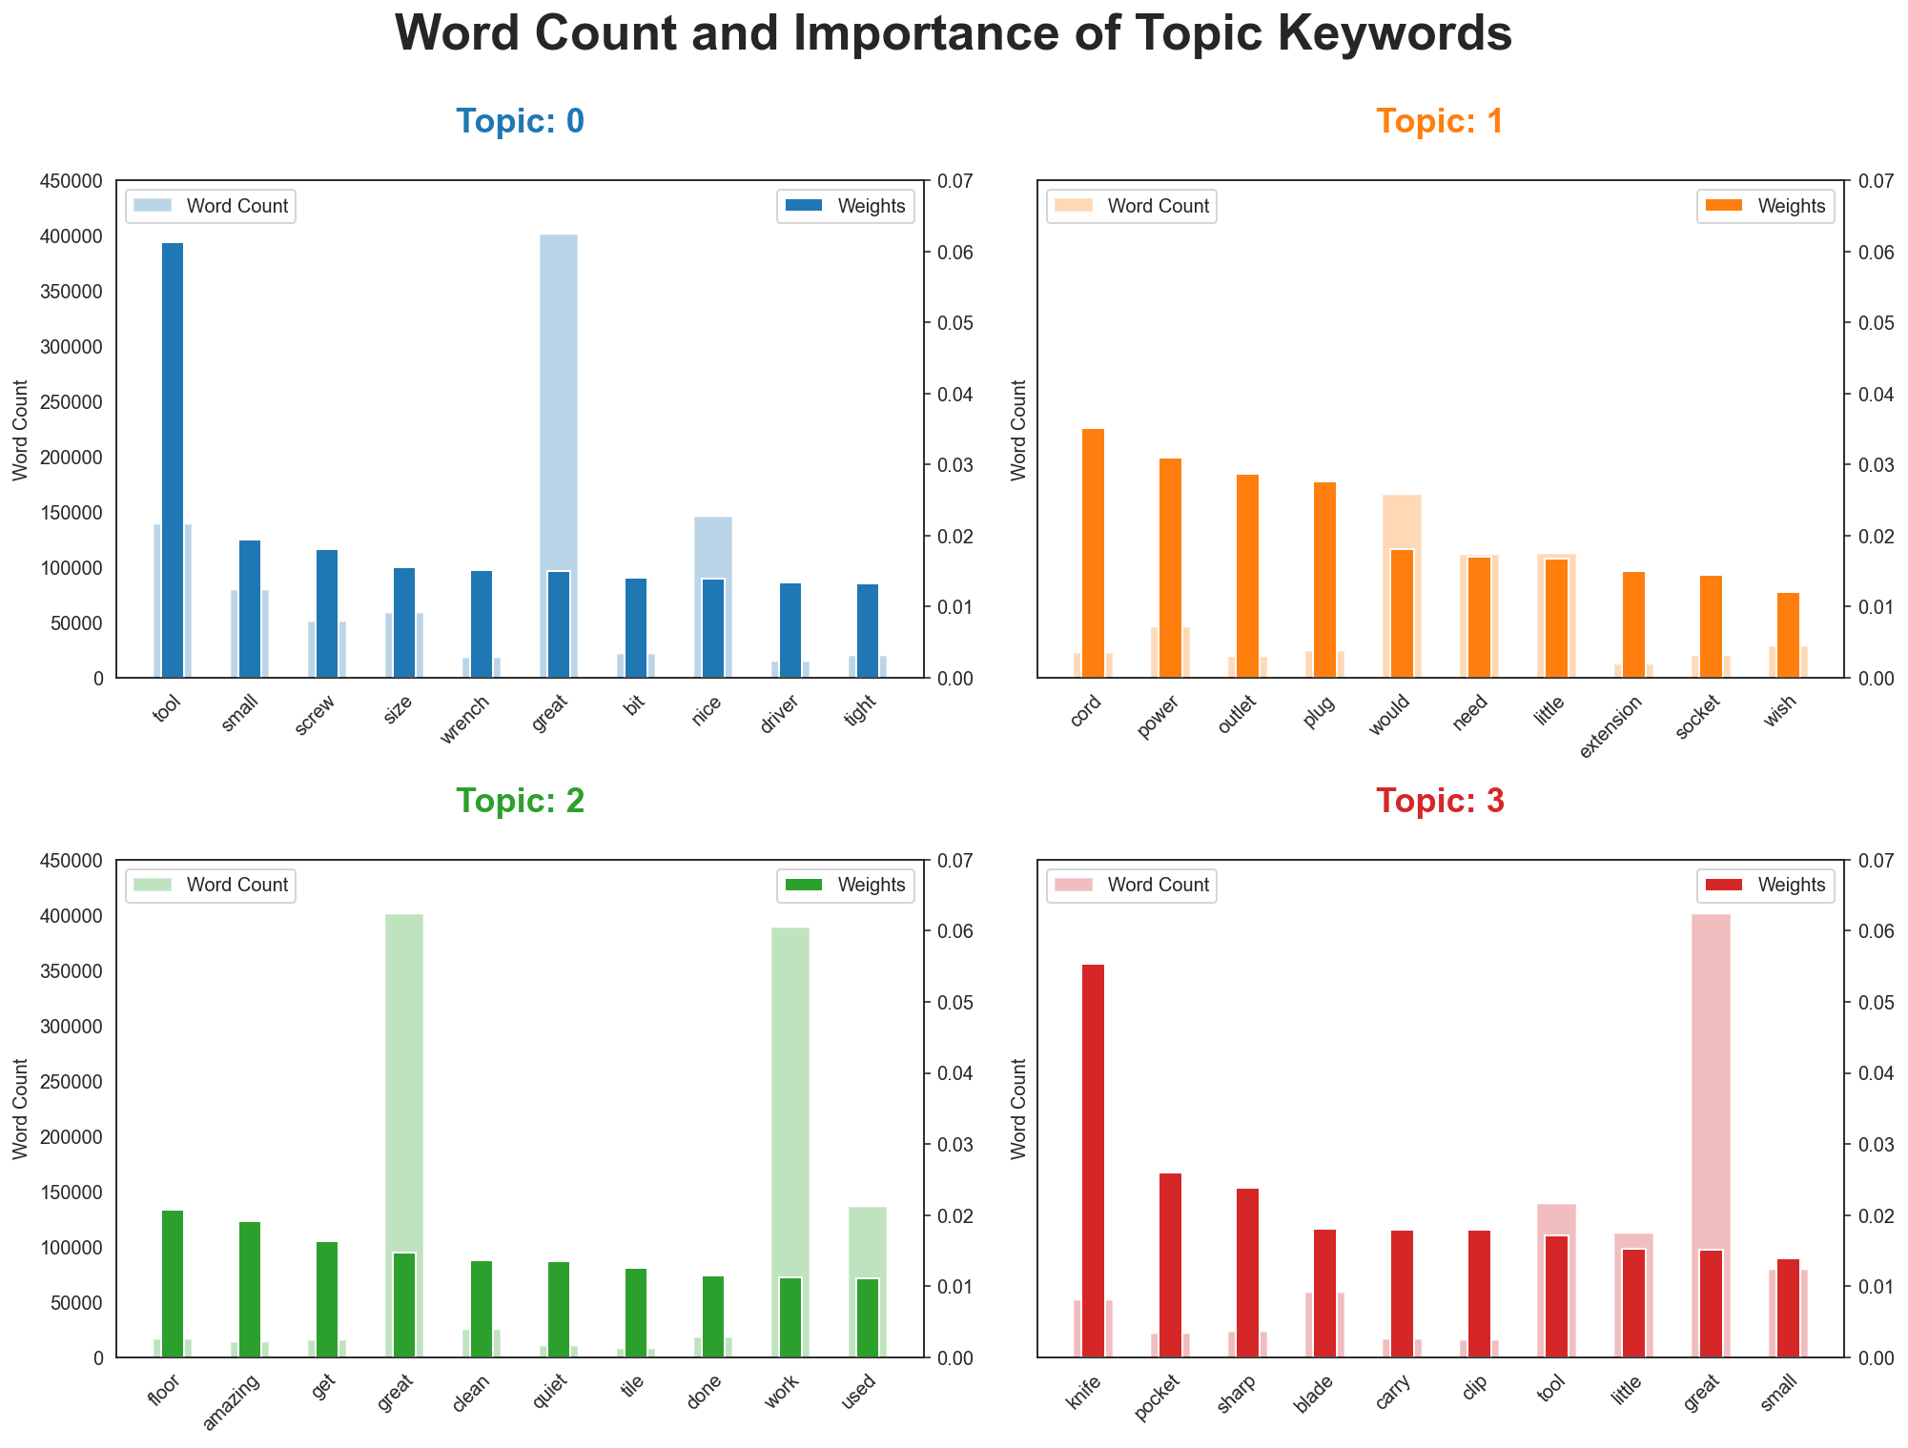
Infer

Slide 13
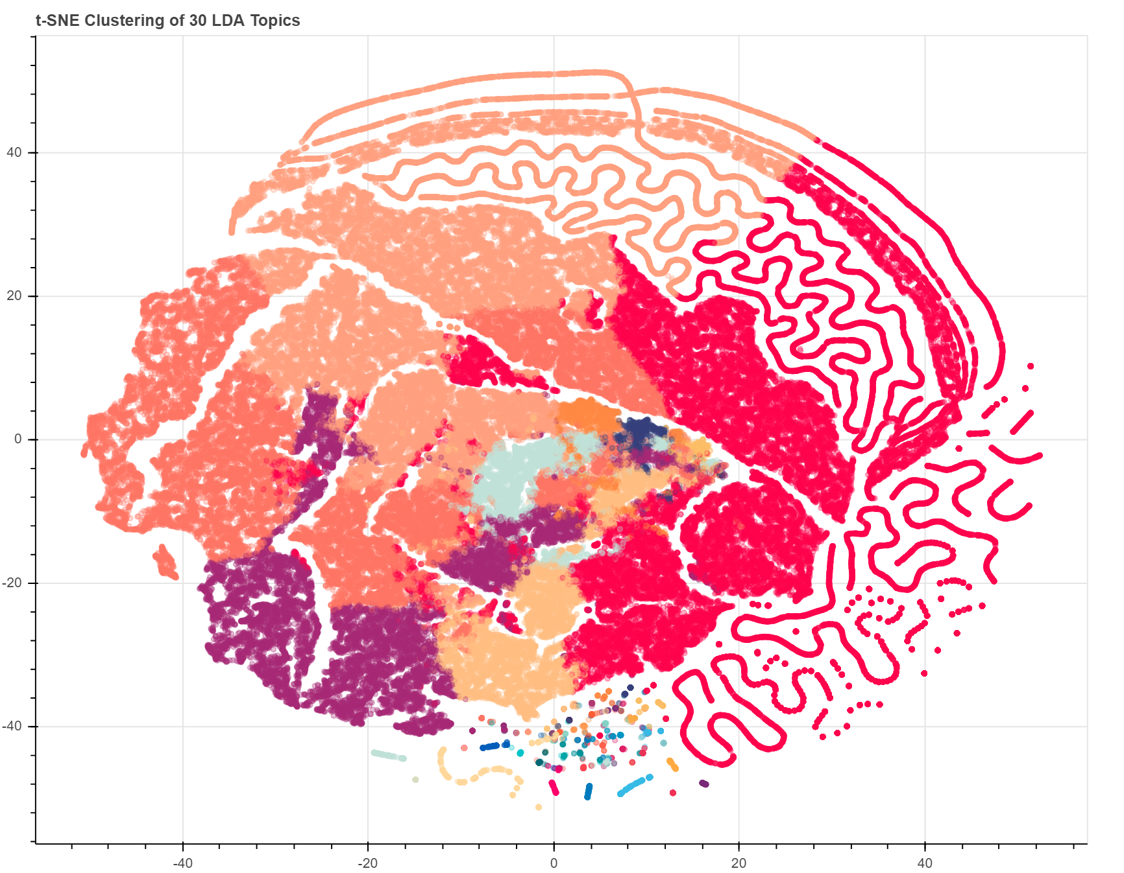
Infer
T-distributed Stochastic Neighbor Embedding(t-SNE)
Notes:
t-Distributed Stochastic Neighbor Embedding (t-SNE) is an unsupervised, non-linear technique primarily used for data exploration and visualizing high-dimensional data
in simpler terms, it provides you a feel of how the data is arranged in a high-dimensional space

Slide 14
Infer

Slide 15
Infer
Notes:
Here is a list of the top 3 documents or reviews with the highest proportion of the dominant topic

Slide 16
Key Factors for Good Segregation of Topics
Quality of text processing
Variety of topics covered in the text
Choice of modelling algorithm
Number of topics parameter provided to the algorithm
Tunning parameters of the algorithm
Notes:
I want you to place your attention specifically on the second point. Now suppose..

Slide 17
Recommendations / Next Steps
Get a machine with a more powerful CPU and more RAM
Include more review data from other product categories
Model hyperparameters tuning
Explore pretrained models and retraining them
Notes:
Or possibly a cluster of machines.. Only working with Tools and Home Improvement category..
I will be demoing pretrained models later, although very briefly

Slide 18
Demo Mode!
Notes:
In simple words, zero-shot model allows us to classify data, which was not used to build a model. I’m going to run it against my data to compare the results

